Slide 1
Enriching Ontology with Temporal Commonsense for Low-Resource Audio Tagging
Zhiling Zhang, Zelin Zhou, Haifeng Tang, Guangwei Li, Mengyue Wu, Kenny Q. Zhu
CIKM 2021
Notes:
Hi everyone, I’m Zelin. Nice to see you again this semester!
In this talk, I’ll introduce you with the latest paper we’ve published on CIKM 2021
“Enriching Ontology with Temporal Commonsense for Low-Resource Audio Tagging”

Slide 2
Outline
Introduction
Method
Experiments
Conclusion

Slide 3
Outline
Introduction
Method
Experiments
Conclusion
Notes:
Let’s come to the introduction part first

Slide 4

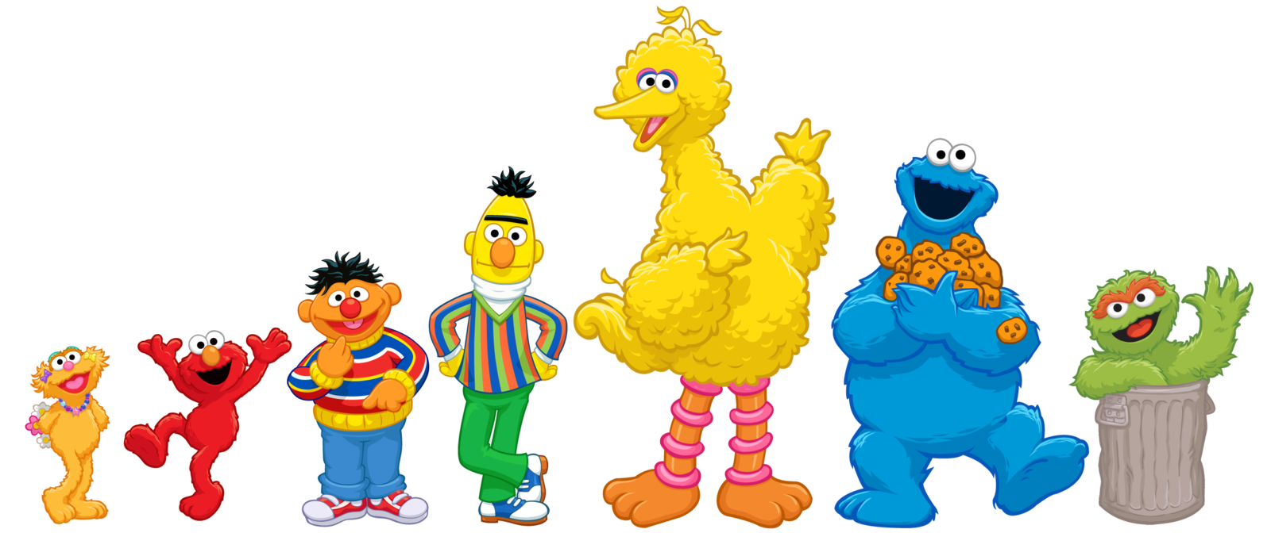

Enriching Ontology with Temporal Commonsense for Low-Resource Audio Tagging
Notes:
For most of you, this long title must be quite a difficult Natural Language Understanding task. So, I will decompose this title into several parts and explain them separately.

Slide 5
Enriching Ontology with Temporal Commonsense for Low-Resource Audio Tagging
Notes:
I‘ll begin with the two kinds of structured knowledge resources, which is ontology and temporal commonsense

Slide 6
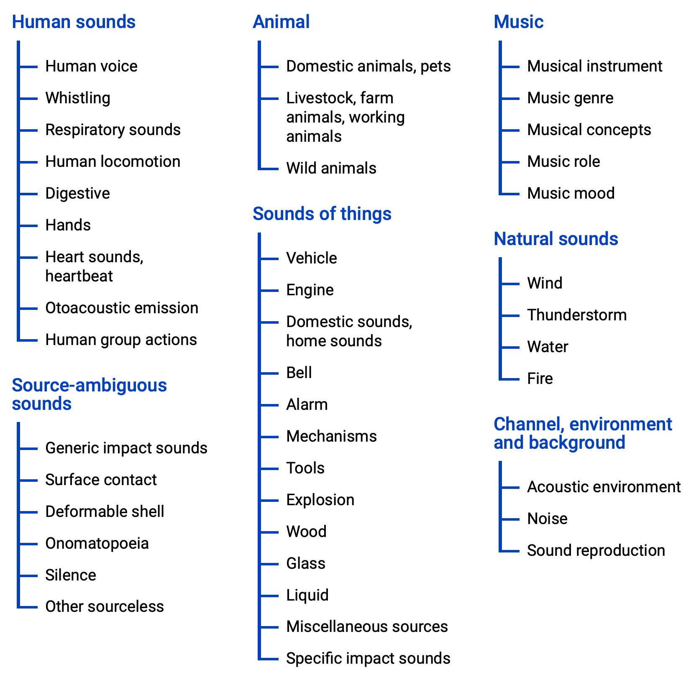


Structured Knowledge
The largest sound vocabulary and dataset
AudioSet Ontology
A collection of sound events organized in a hierarchy
Notes:
(click)
AudioSet is the largest sound vocabulary and dataset for audio pattern recognition tasks, comprising of over 5.8 thousands hours of audios and 527 classes of annotated sounds
(click)
The AudioSet ontology is a part of AudioSet, meanwhile it is collection of sound events organized in a hierarchy,
(click)including 7 top level sound events and total 632 fine-grained events
(click)

Slide 7
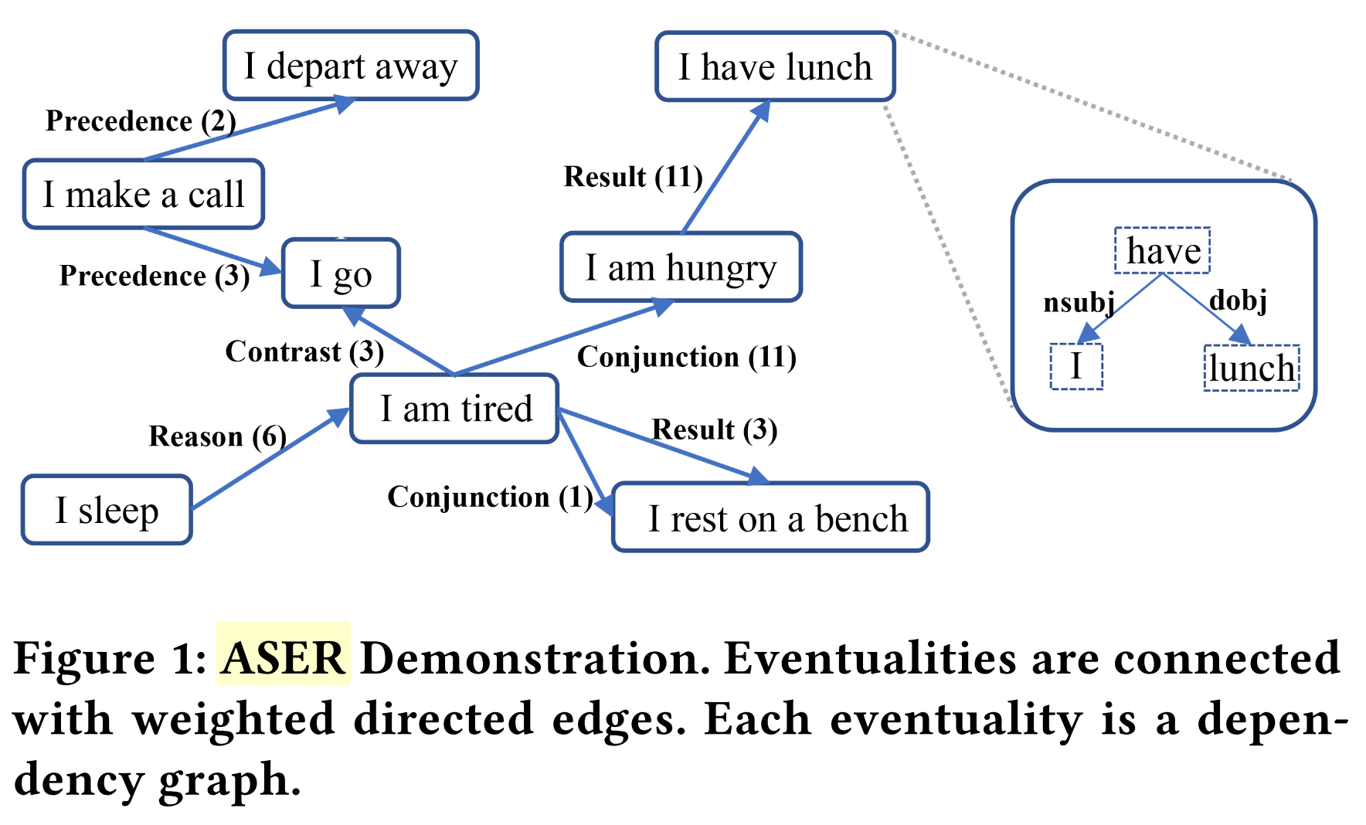
Structured Knowledge
ASER
A large-scale eventuality knowledge graph extracted from corpus
Q1: Temporal Commonsense ?
Short clauses containing lemmatized words:
Subject → Verb → Object
Notes:
ASER is a large-scale eventuality knowledge graph, which means in ASER each node represents an event
(click) here is a demo of ASER
an eventuality is represented as a short clause containing lemmatized words, usually in the form of Subject,Verb,Object
(click) for example, ”I have lunch” could be represented as such a dependency graph
here we can see in this example, events in ASER are linked with different edges, like “I am tired” are in conjunction with ”I am hungry”, or…
(click)
So the first quiz is —— what is the temporal commonsense relation in this graph?

Slide 8
Enriching Ontology with Temporal Commonsense for Low-Resource Audio Tagging

Slide 9
Enriching ontology
Q: Why shall we enrich AudioSet ontology?
A: Not enough relation types and linkages
AudioSet: IsA
ASER: Precedence, Succession, Synchronous, Conjunction, etc.
IsA
Speech
Human voice
IsA
Car
Motor Vehicle
Conjuntion
Engine be whirring
Vehicle pass
Precedence
Horn be blaring

Slide 10
Enriching ontology
How to enrich?
Entity Alignment
Entity Alignment is the task of finding entities in two knowledge
bases that refer to the same real-world object.
It plays a vital role in automatically integrating multiple knowledge
bases.

Slide 11
AudioSet
Engine
Vehicle
Human voice
Accelerating,
revving
Motor vehicle
Speech
Idling
Car
Male speech
Screaming
Car alarm
Engine rev
You say
Vehicle approach
People scream
Engine start
Vehicle pass
Siren blare
Ontology Links
Temporal Links
Alignments
Enriched Links
Car start
ASER
Engine idle
Car alarm chirp

Slide 12
Enriching ontology
Challenges for alignment:
1. Expression style mismatch
ASER is much larger than AudioSet
⇒ 1 AudioSet event might map to n ASER events
2. Acoustic relatedness≠Semantic similarity
Vehicle approach
Vehicle
He be driving a car
Vehicle pass
❌
✅
Engine
I see Engine
Male Speech
He say

Slide 13
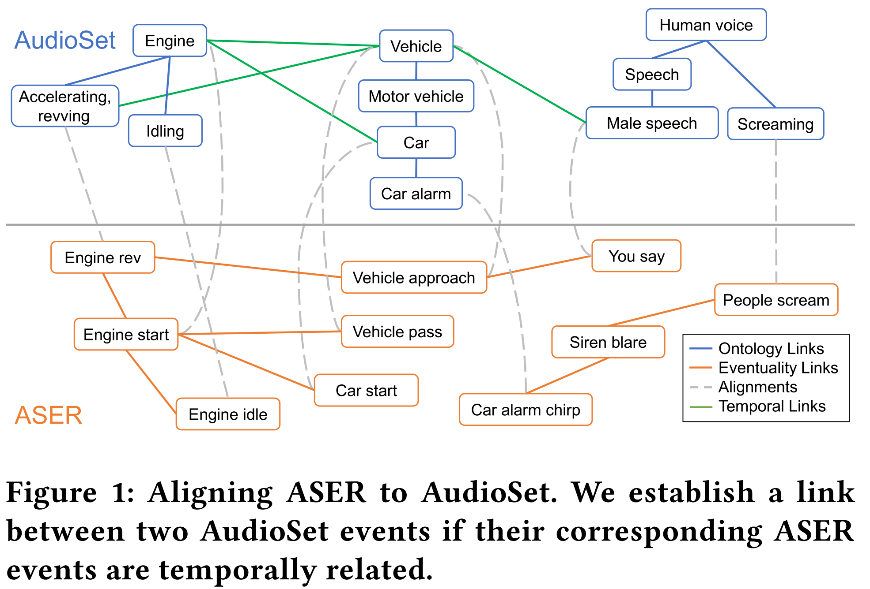
Enriching ontology
Relation in ASER
Relation in AudioSet
transfer

Slide 14
Enriching Ontology with Temporal Commonsense for Low-Resource Audio Tagging

Slide 15
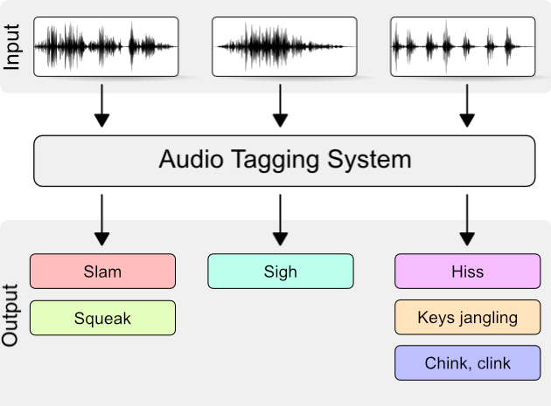

Audio Tagging
Downstream task: Audio Tagging
⇒ Audio tagging aims at predicting sound events occurred in a recording.
✅
Motorcycle
Water
Traffic noise and roadway noise
Birds chirping
Vacuum cleaner
Dog
Alarm
✅
🤔 Co-occurrence?

Slide 16
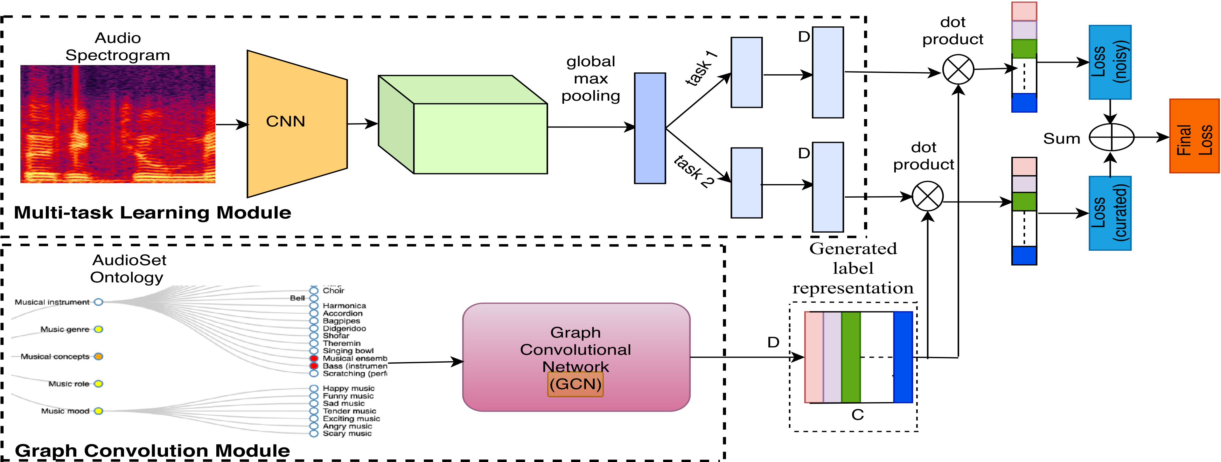
How do we solve Audio Tagging problem
Normal: Audio feature → CNN → label Classification
Label representation

Slide 17
Outline
Introduction
Method
Experiments
Conclusion

Slide 18
Knowledge construction
Pipeline of enriching AudioSet Ontology
Enriched
ASER
Manual
Selection
Preprocessing
Queries
Candidate
alignments
Selected
alignments
Expansion
Retrieval
Heuristic
Selection
Original

Slide 19
Knowledge construction
Queries:
vehicle horn
Preprocessing and Expansion
automobile horn
vehicle horn
car horn
separate
&
lemma
WordNet
&
WSD(LESK)
Vehicle horn, car horn, honking
car horn
horn
motor horn
Description:
The sound of a motor vehicle accessory
whose purpose is to provide
an audible alert of the vehicle's presence.
honk
hoot
Synset
derivationally_related_forms
claxon
honk

Slide 20
Knowledge construction
Alignment Candidate Retrieval (queries → ASER → candidates)
Apply a filter for noisy pattern(I say say) and infrequent events
⇒ more general and frequent events & more linked relations
Selection
Human annotation for acoustic property:
whether a candidate in ASER is: related, unrelated or ambiguous to
corresponding event in AudioSet
Construction
Events in AudioSet will inherit the relations in ASER

Slide 21
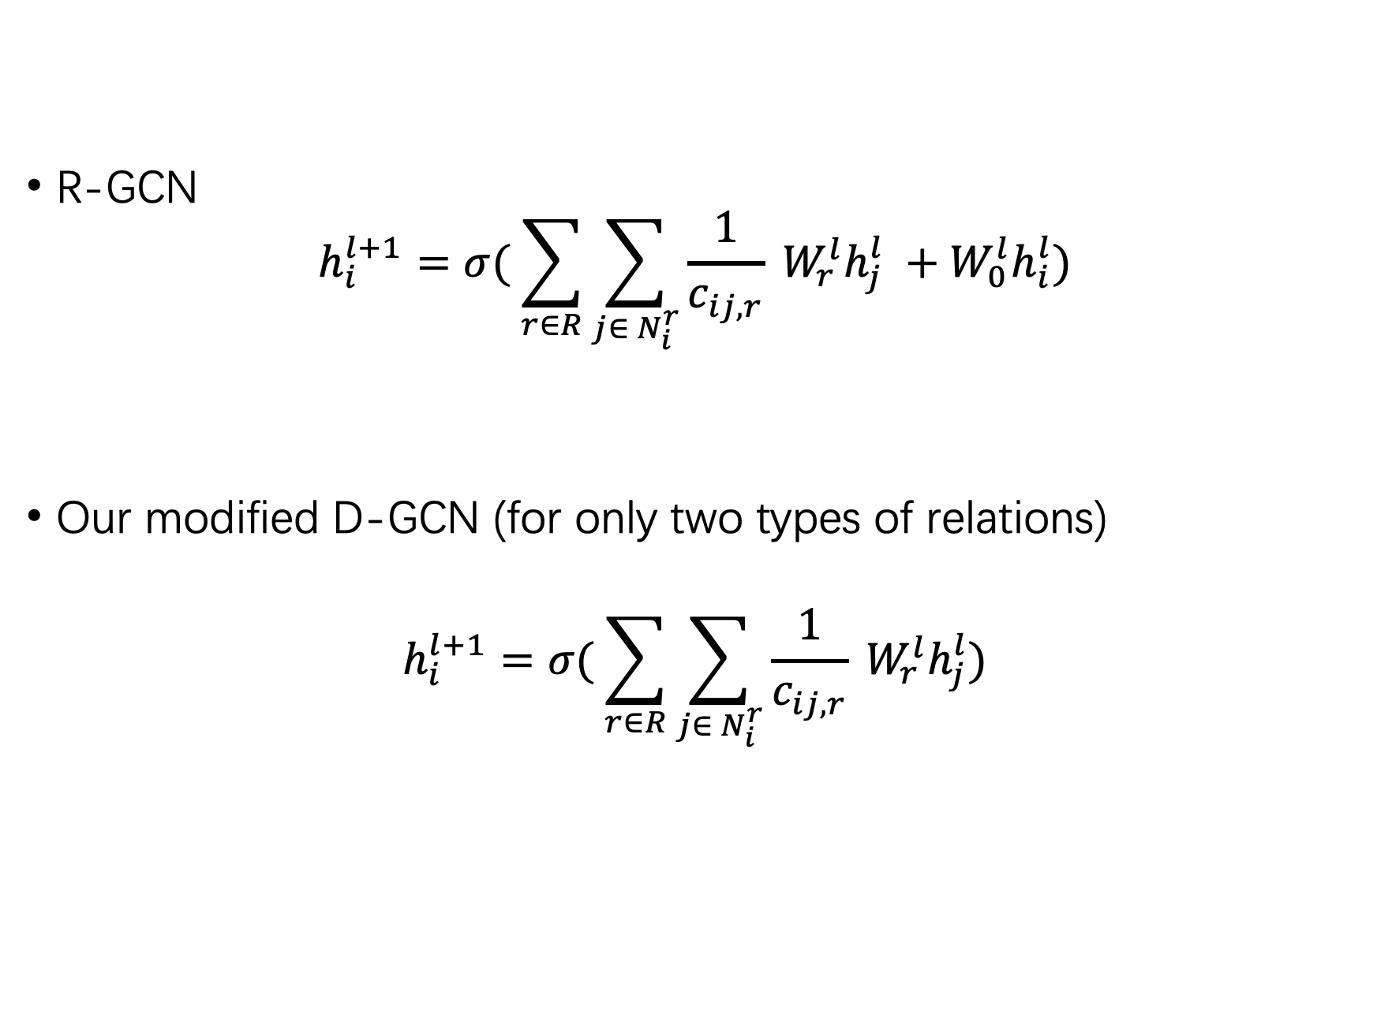
Label Representation
Weight matrix
R-GCN
$$h_{i}^{l+1}=σ( \sum_{r∈R}{\sum_{j∈ N_{i}^{r}}{\frac{1}{c_{ij, r}}}} W_{r}^{l}h_{j}^{l} +W_{0}^{l}h_{i}^{l})$$
Our modified D-GCN (for only two types of relations)
$$h_{i}^{l+1}=σ( \sum_{r∈R}{\sum_{j∈ N_{i}^{r}}{\frac{1}{c_{ij, r}}}} W_{r}^{l}h_{j}^{l})$$
Regularizer
Feature
Normalize
Relations
Neighbors
Q: Why we remove the regularizer here?

Slide 22
Outline
Introduction
Method
Experiments
Conclusion

Slide 23
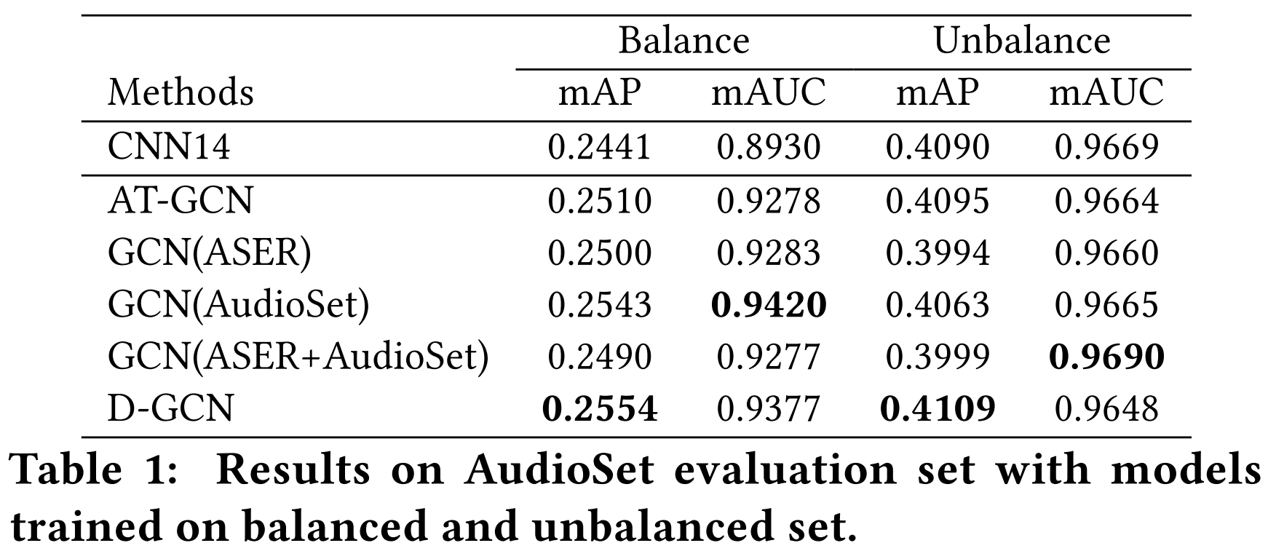
AudioSet
Only IsA relation

Slide 24
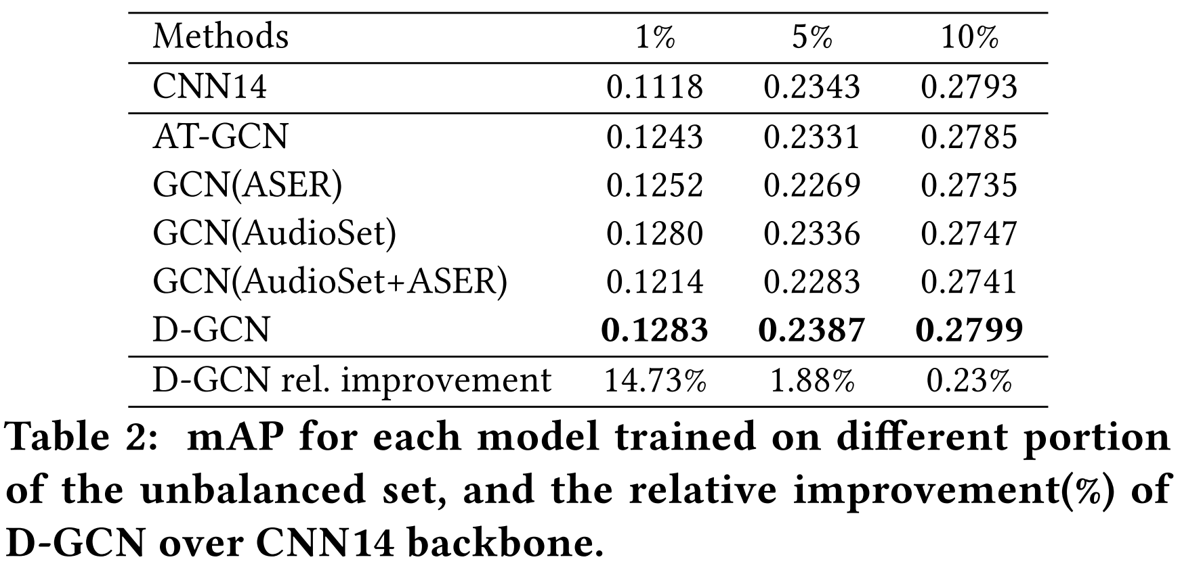
AudioSet

Slide 25
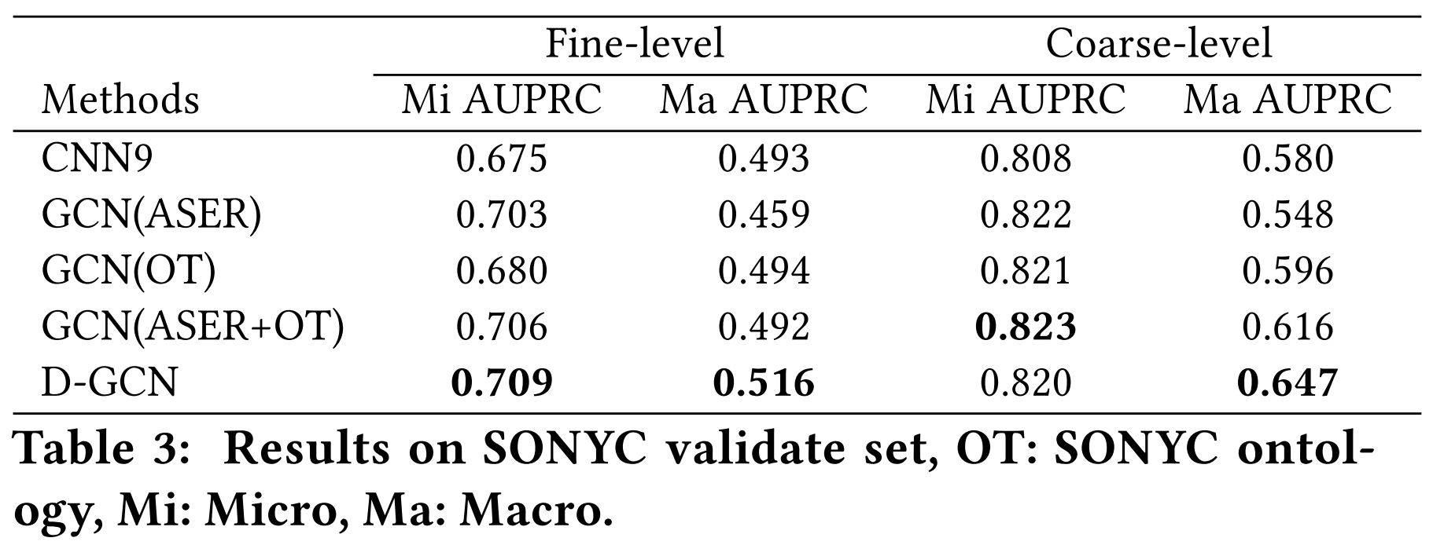
SONYC

Slide 26
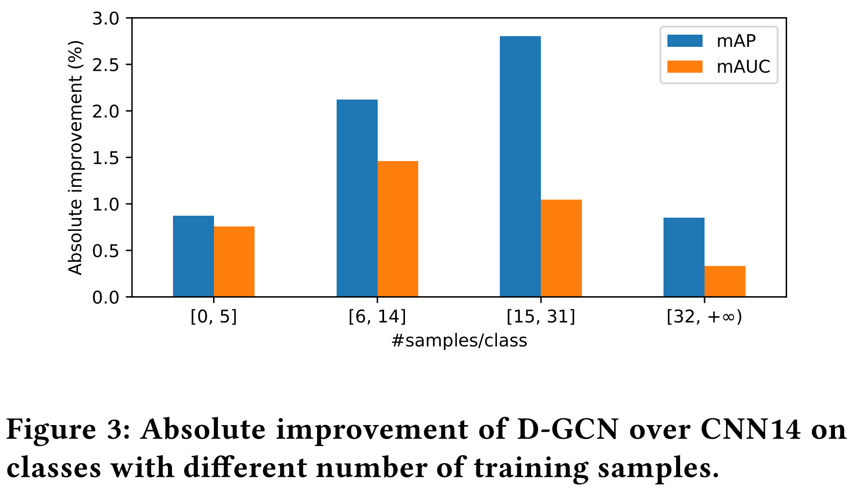
Analysis
Few shot
Extreme few

Slide 27
Outline
Introduction
Method
Experiments
Conclusion

Slide 28
Conclusion
Propose a semi-automatic procedure to enrich existing ontologies
Further propose D-GCN combining two kinds of knowledge
Results on AudioSet and SONYC in low-resource scenario shows:
⇒ GCN model with temporal knowledge outperforms baseline
⇒ D-GCN can provide further improvement

Slide 29
Thanks!

Slide 31
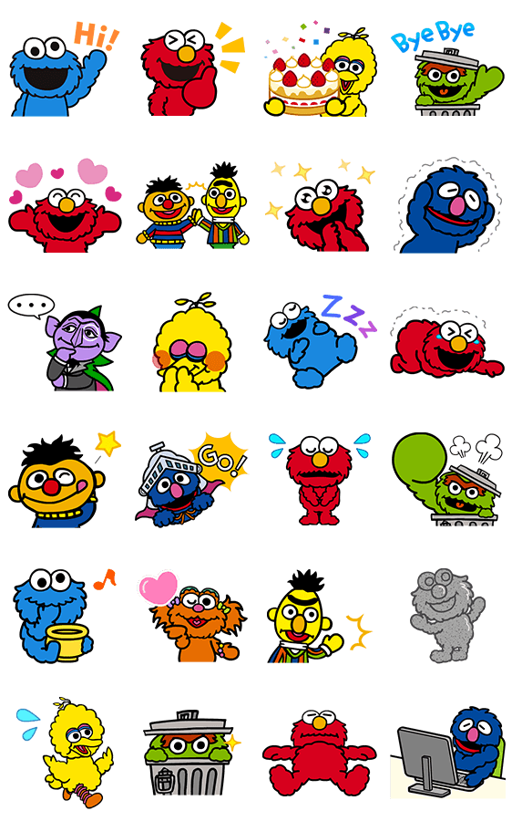
Notes:
To begin with, I’d like to decompose this long and confusing title, “Enriching Ontology with Temporal Commonsense for Low-Resource Audio Tagging”

